Slide 1
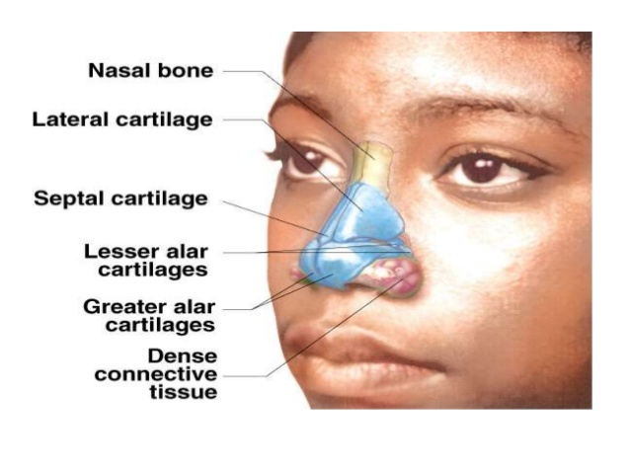
ANATOMY OF EXTERNAL NOSE
MOHAMMED HUSSAIN – 15M084

Slide 2
OSTEOCARTILAGINOUS FRAMEWORK
Pyrimidal in shape with its root up and base directed downwards
Upper one-third is bony while lower one-third is cartilaginous
Bony part consists of 2 nasal bones which meet in midline and rest on the upper part of nasal process of the frontal bones and are themselves held betweeen the frontal process of maxillae.

Slide 3
CARTILAGINOUS PART
It consists of
UPPER LATERAL CARTILAGE – They extend from undersurface of the nasal bone above to alar cartilages below. The lower free edge is seen intranasally as limen vestibuli or nasal valve.
LOWER LATERAL CARTILAGES – It is U-shaped. It has a lateral crus which forms the ala and a medial crus which runs in the colmunella. Lateral crus overlaps lower edge of upper lateral cartilage on each side.

Slide 4
LESSER ALAR CARTILAGE- Two or more. They lie above and lateral to alar cartilages. Various cartilages and connected to each other and with the adjoining bone by perichondrium and periosteum.
SEPTAL CARTILAGE- Its anterosuperior border runs from under the nasal bones to the nasal tip. It supports dorsum of the nose. It septal abscess or excessive removal of septal cartilage as in SMR operation, support of nasal dorsum in lost and results in supratip depression.

Slide 5
NASAL MUSCULATURE
They bring about movement of nasal tip,ala and the overlying skin.
They are procerus, nasalis, levator labii superioris alaeque nasi, anterior and posterior nares and depressor septi.
NASAL SKIN
The skin over nasal bones and upper lateral cartilages is thin and free while that covering the alar cartilages is thick and adherent, and contains many sebaceous glands. Hypertrophy of these glands can cause a lobulated tumour called rhinophyma

